Slide 1

WSO2 API Manager 4.2.0 Developer Advanced
Deployment Patterns
WSO2 Training

Slide 2
Deployment Patterns
Notes:
https://apim.docs.wso2.com/en/4.2.0/install-and-setup/setup/deployment-overview/

Slide 3
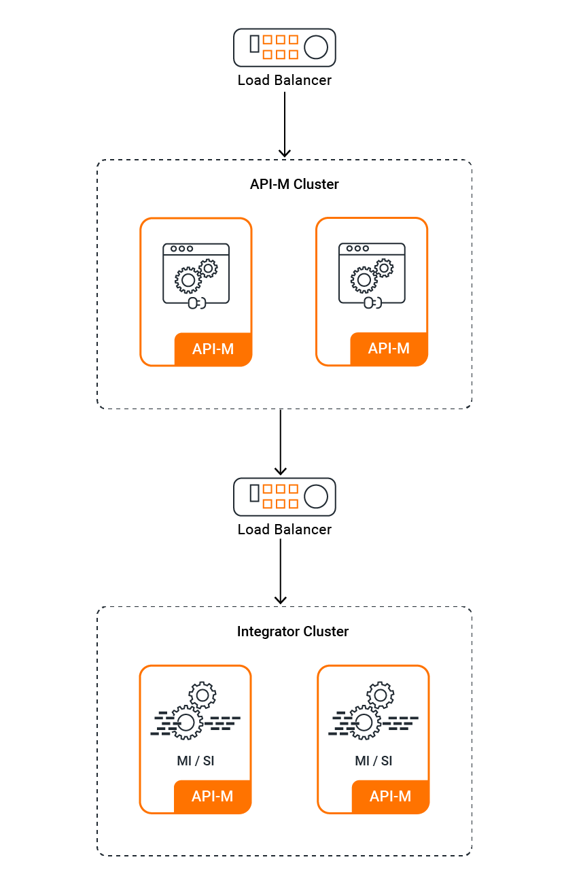
Pattern #1: Standard HA Deployment
This deployment consists of an API-M cluster with two nodes of the API-M runtime and two nodes each of the integration runtimes (Micro Integrator/Streaming Integrator). You can use this pattern if you expect to receive low traffic to your deployment.
Standard HA deployment with multi-tenancy

Slide 4
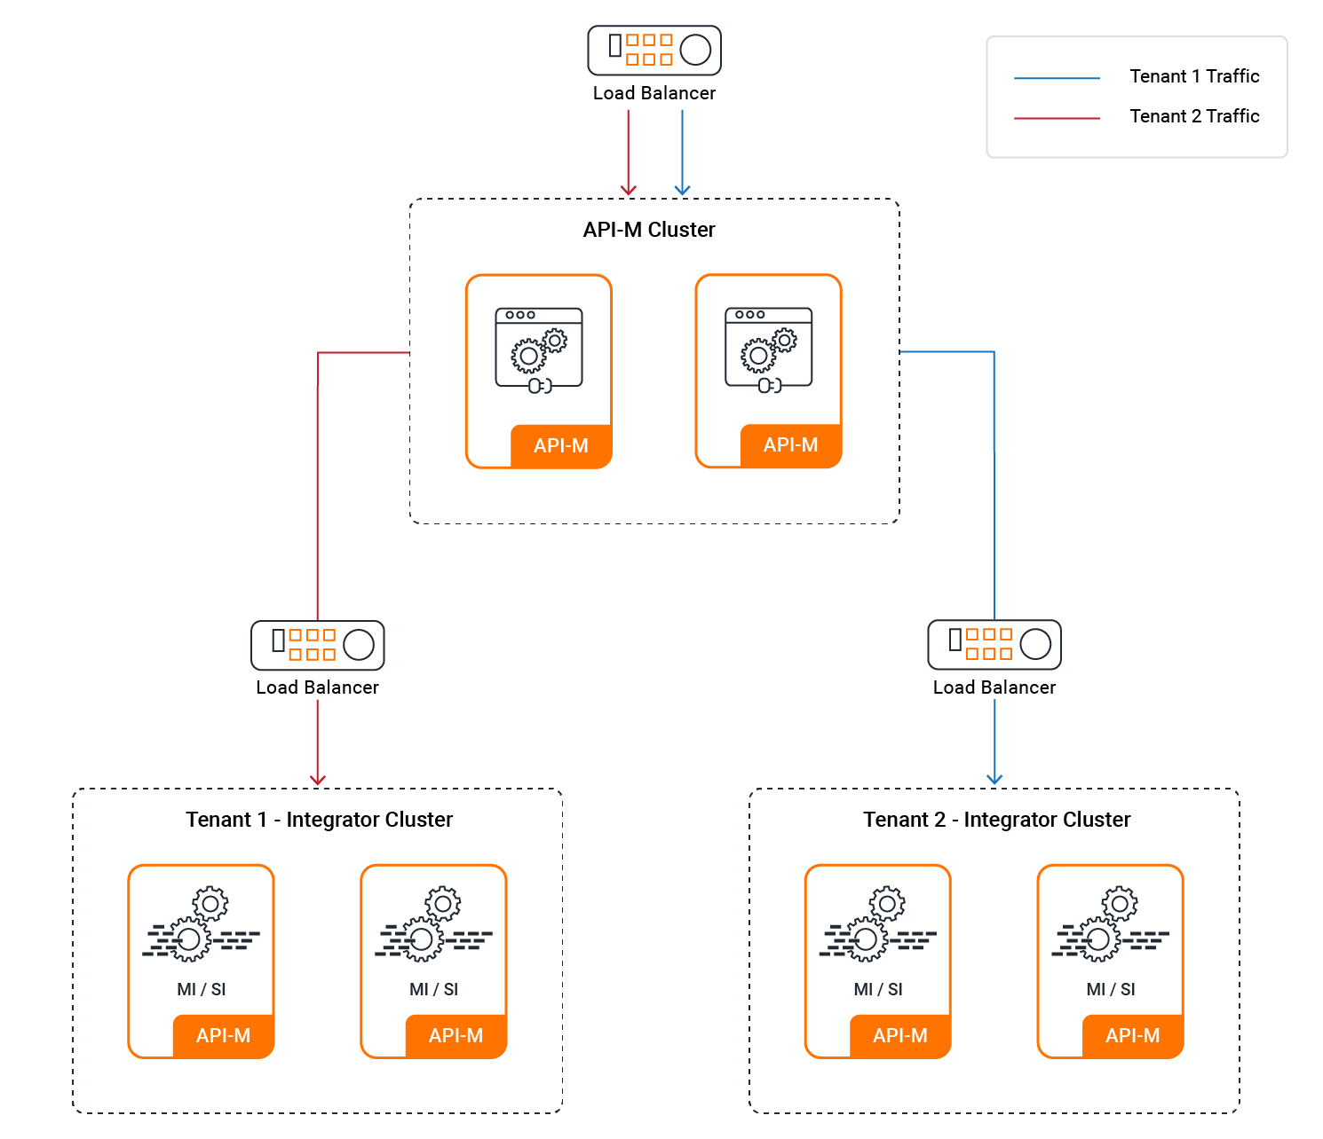
Pattern #2 - Standard HA Deployment with Multitenancy
This deployment consists of two API-M nodes and two nodes each of the integration runtimes (Micro Integrator/Streaming Integrator) per tenant. You can use this pattern when traffic from different tenants in the API-M cluster needs to be handled in isolation. This deployment also allows you to direct the traffic of each tenant to a separate integration cluster.
Standard HA deployment with multi-tenancy

Slide 5
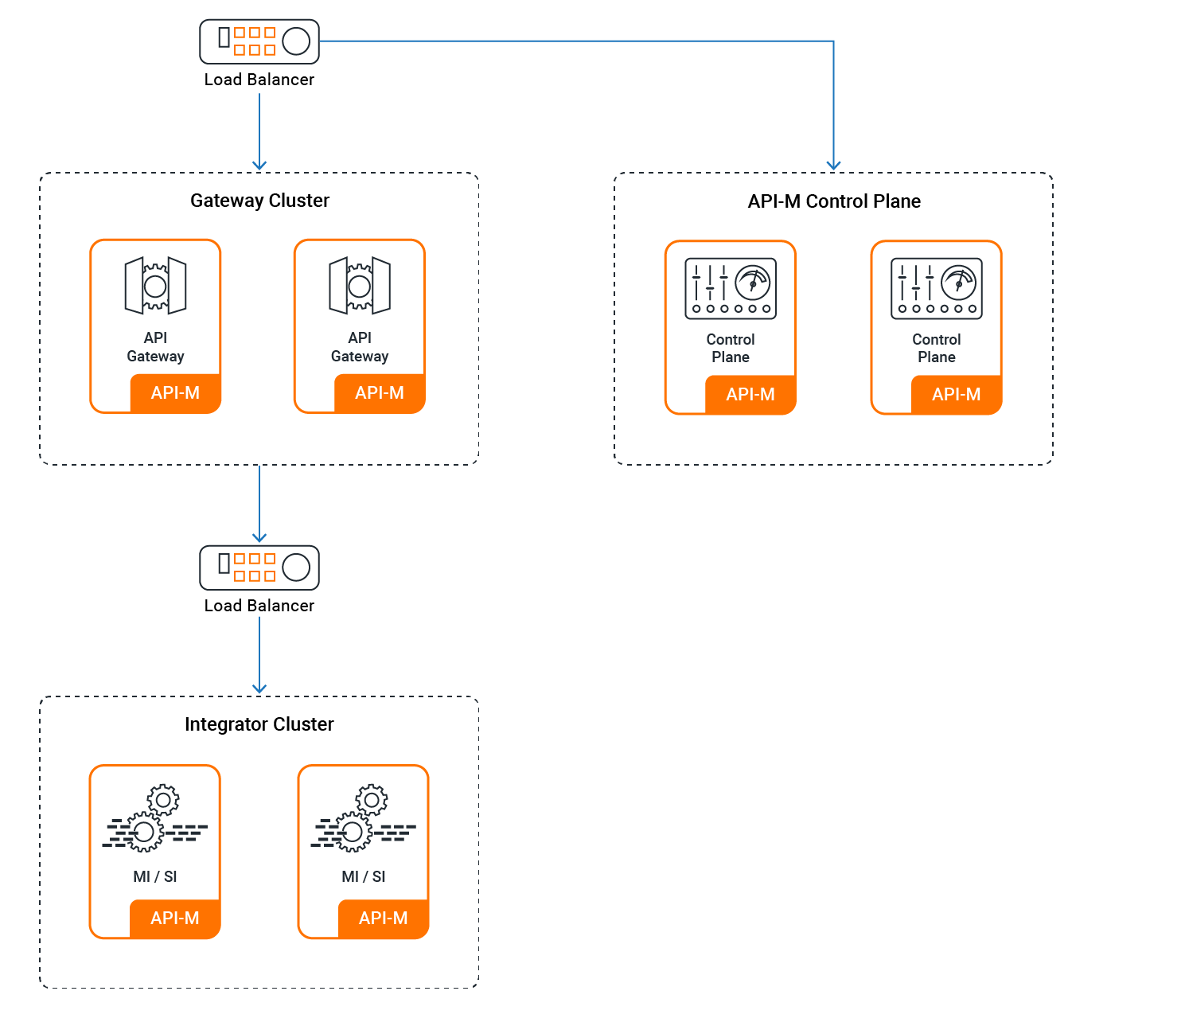
Pattern #3 - Simple Scalable Deployment
This pattern allows you to scale the deployment on demand. The simple scalable deployment pattern shown below illustrates a deployment that uses minimum resources. However, this setup can easily be scaled.
Simple scalable deployment

Slide 6
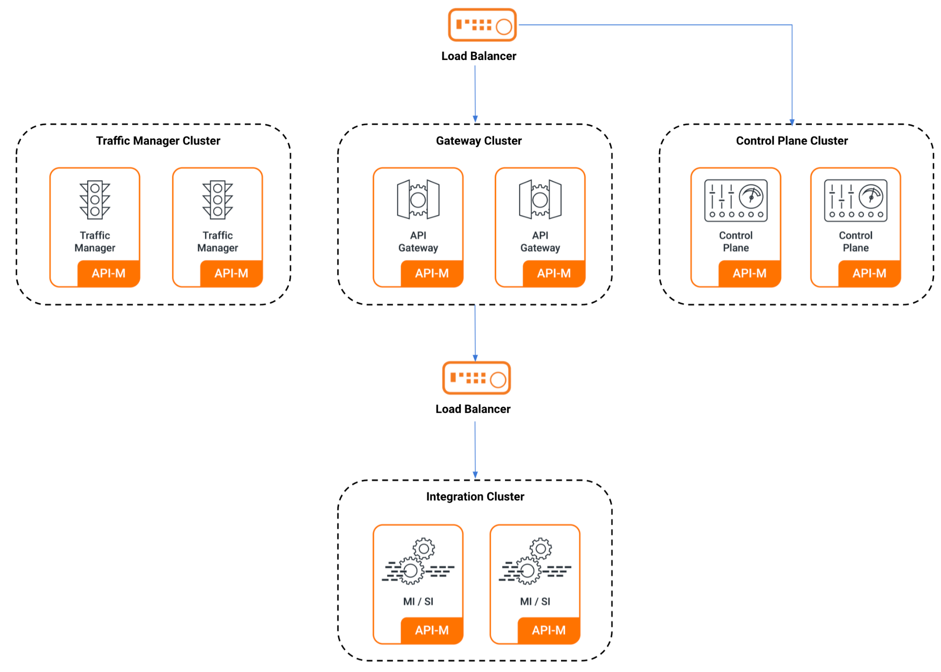
Pattern #4 - Simple scalable deployment with Traffic Manager separation
This pattern allows you to scale the deployment on demand. This deployment pattern can be used only when you need to run the Traffic Manager nodes separately due to deployment complexities.
Simple scalable deployment with Traffic Manager separation

Slide 7
Deploying API Manager Using Single Node Instances

Slide 8
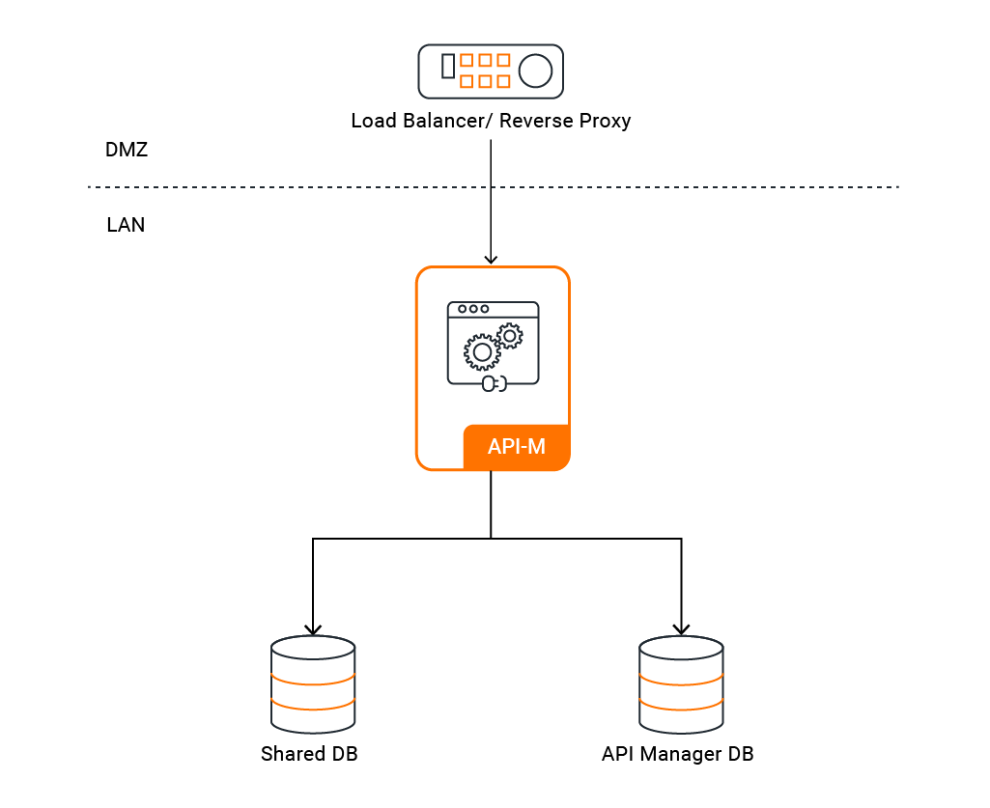
Single Node deployment
API traffic is served by single all-in-one instance of WSO2 API Manager
Configuring a Single Node

Slide 9
Single Node deployment
Pros
Production support is required only for a single API Manager node (you receive 24*7 WSO2 production support).
Deployment is up and running within a short period as the effort and time required to setup this deployment is less.
Can handle up to 43 million API calls a day (up to 500 API calls a second)
Minimum hardware/cloud infrastructure requirements (only one node).
Suitable for anyone new to API Management.
Cons
Deployment does not provide High Availability.
Not network friendly. Deploying on a demilitarized zone (DMZ) would require a Reverse Proxy.

Slide 10
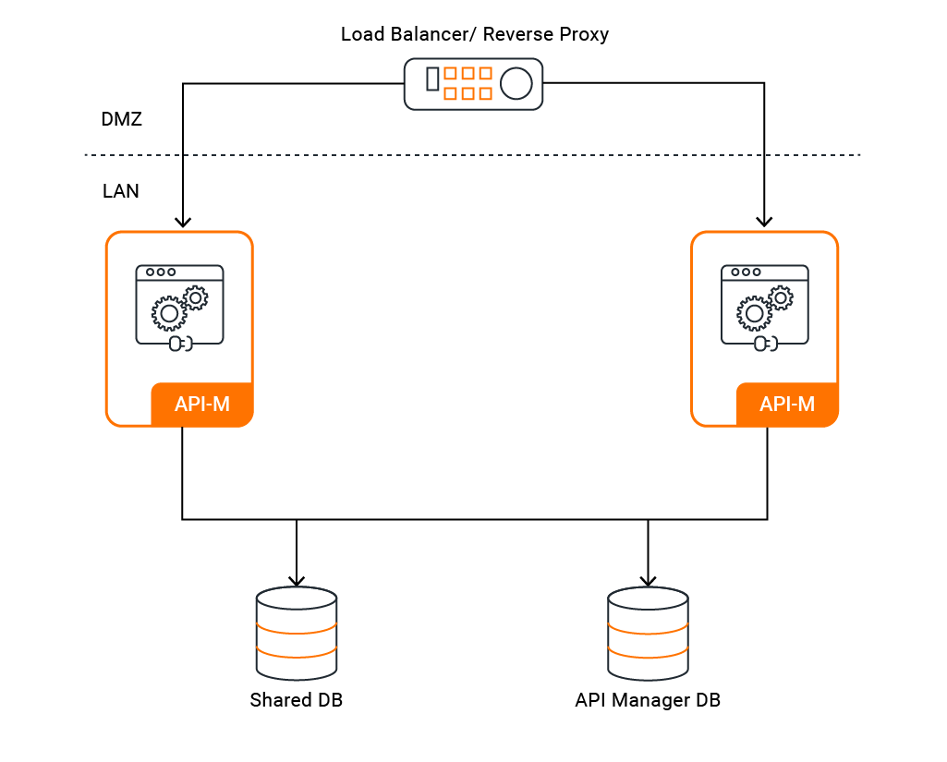
Active - Active deployment
API traffic is served by two, all-in-one instances of WSO2 API Manager.
Configuring an Active-Active Deployment

Slide 11
Active - Active deployment
Pros
The system is highly available.
Production support is required for 2 API Manager nodes (you receive 24*7 WSO2 production support).
Can handle up to 86 million API calls a day (up to 1000 API calls a second)
Deployment is up and running within hours.
Cons
Not network friendly. Deploying on a DMZ would require a Reverse Proxy.

Slide 12
Distributed Deployment

Slide 13
Product Profiles
When a WSO2 product starts, it starts all components, features and related artifacts bundled with it.
But when deploying API Manager in a distributed manner, every node does not need to have all the components.
Eg: Gateway does not need Publisher/ Devportal components etc.
For this, API Manager has a concept called “Profiles” and has three main profiles.
Control Plane
Traffic Manager
Gateway
When running the product as profiles, each profile will load only the required OSGi bundles and components to that specific node.

Slide 14
Product Profiles
Profile | Command | Description
Gateway Profile | -Dprofile=gateway-worker | Starts server as Gateway
Control Plane Profile | -Dprofile=control-plane | Starts server as Control Plane
Traffic Manager Profile | -Dprofile=traffic-manager | Starts server as Traffic Manager
Product Profiles

Slide 15
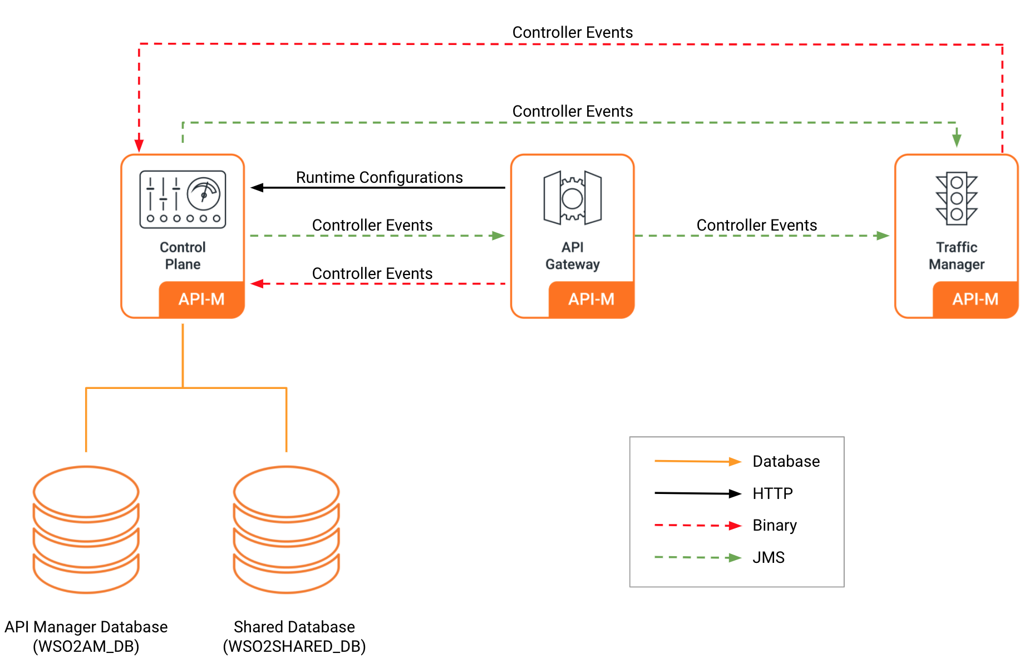
Creating the Distributed Deployment
Understanding the Distributed Deployment of WSO2 API-M

Slide 16
Databases
WSO2 API Manager components use the databases as follows:
 | API Manager Database apim_db WSO2AM_DB | Shared Database shared_db WSO2SHARED_DB
Gateway Worker | Not Used | Used (in multi-tenancy mode/ in multiple gateway mode when Google Analytics is used)
Control Plane | Used | Used
Traffic Manager | Used | Used
API Manager Documentation 4.2.0 - Distributed Deployment Overview

Slide 17
Creating the Distributed Deployment
The three components are set up in a distributed deployment based on the selected pattern
The two databases are connected to the relevant components respectively
Notice the port offset and the HTTPS port of each WSO2 server component*
The default communication protocol of Key Manager is WSClient
The entire setup will also be fronted by a Load Balancer
*If multiple nodes deploy in the same physical machine or vm.
Deploying API-M in a Distributed setup

Slide 18
Let’s try it out!
Deploy WSO2 API Manager Pattern #1

